Slide 1



SUPER MARIO
Home
About
Contact
FINAL PROJECT OOP
Mario is a cheerful plumber and Nintendo's iconic character, famous for his adventures rescuing princesses and overcoming thrilling challenges.

Slide 2


Home
About
Contact
SUPER MARIO
FINAL PROJECT OOP
Mario is a cheerful plumber and Nintendo's iconic character, famous for his adventures rescuing princesses and overcoming thrilling challenges.
SUPER MARIO
Slide
1

Slide 3
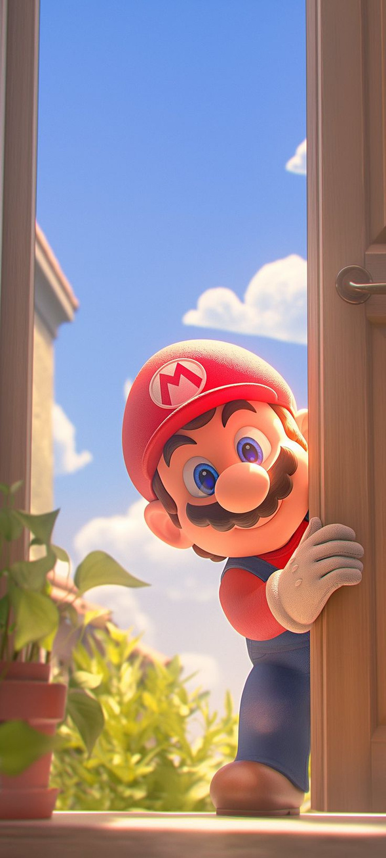


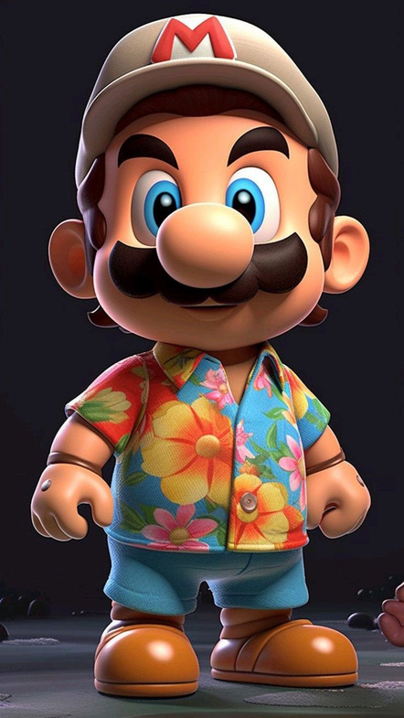
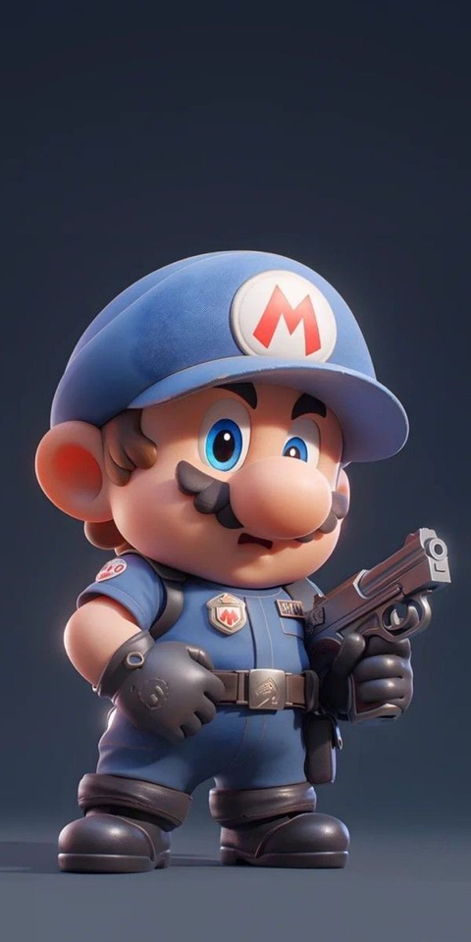

SUPER MARIO
Meet Our Team
Mario is a cheerful plumber and Nintendo's iconic character, famous for his adventures rescuing princesses and overcoming thrilling challenges.
Home
About
Contact
Home
About
Contact
Welcome to Mario
FINAL PROJECT OOP
Mario is one of the most classic and iconic video games in history, developed by Nintendo. The game revolves around Mario, a brave plumber who often teams up with his brother Luigi on a journey to rescue Princess Peach from Bowser, the king of the evil turtles.
SUPER MARIO
Slide
2
SUPER MARIO
TAN KHANH
QUANG HUY
HOANG KHANH
TRUNG KIEN
(ITCSIU23014)
(ITDSIU23038)
(ITCSIU23013)
(ITCSIU23020)

Slide 4

SUPER MARIO
Meet Our Team
TAN KHANH
QUANG HUY
HOANG KHANH
TRUNG KIEN
(ITCSIU23014)
(ITDSIU23038)
(ITCSIU23013)
(ITCSIU23020)
UML and Project structure.
Load game and menu.
Load level data, enemies and player.
Player functions, Keyboard and Mouse input.

Slide 5

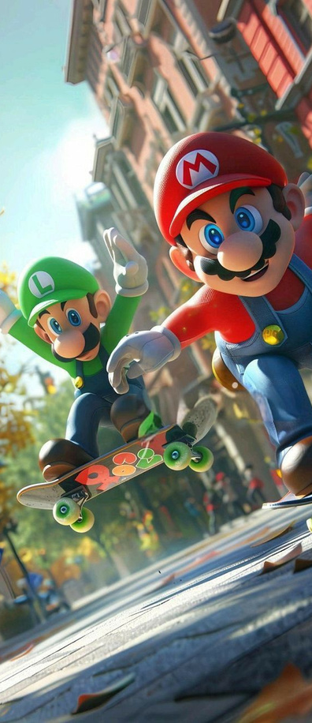

CONTENTS
UML and Project structure.
Load level data, enemies and player.
Collision and gravity
Menu game

Slide 6
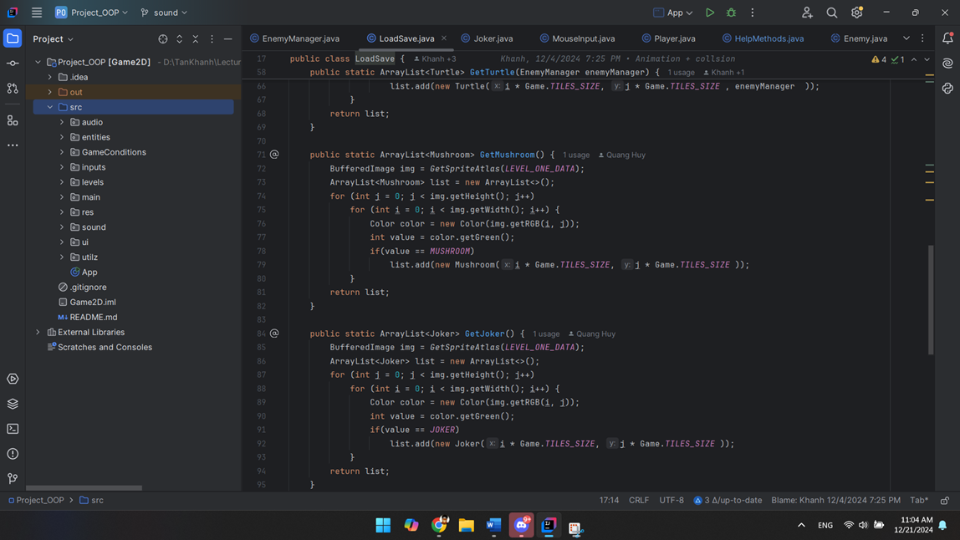
PROJECT - STRUCTURE
SUPER MARIO

Slide 7
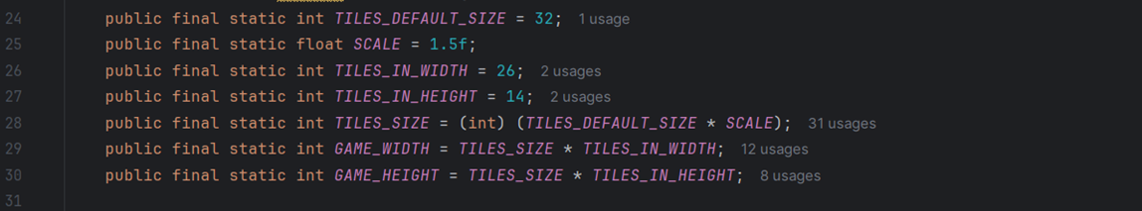
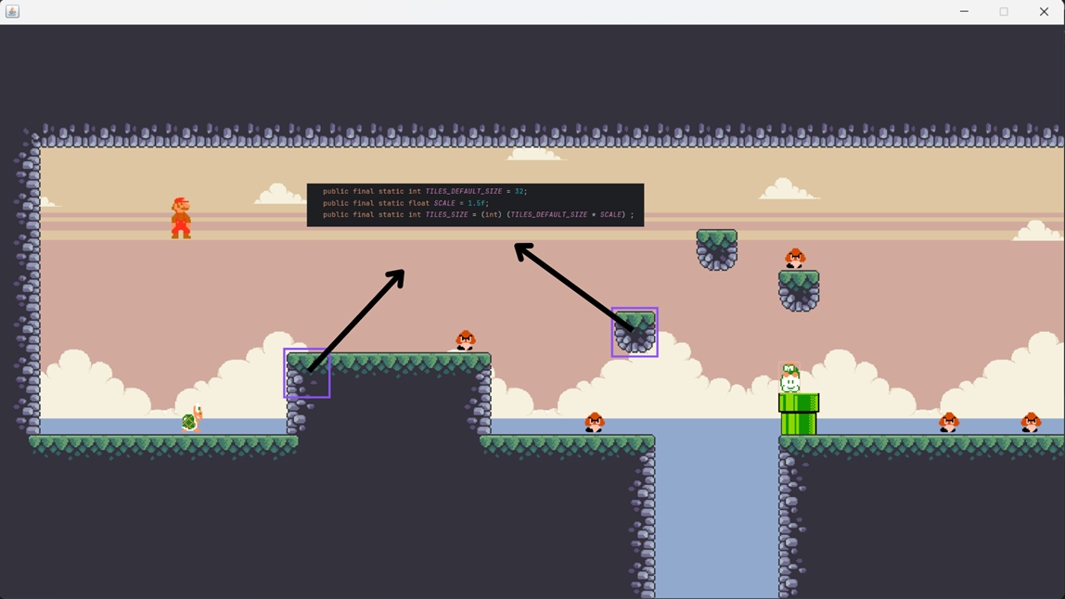
LEVEL DATA - GAME CONSTANT
SUPER MARIO

Slide 8
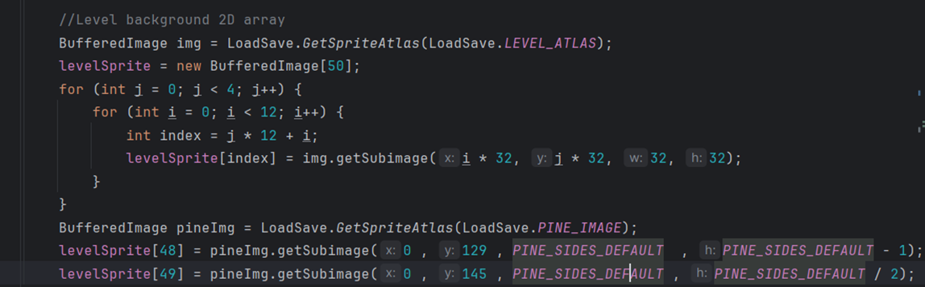
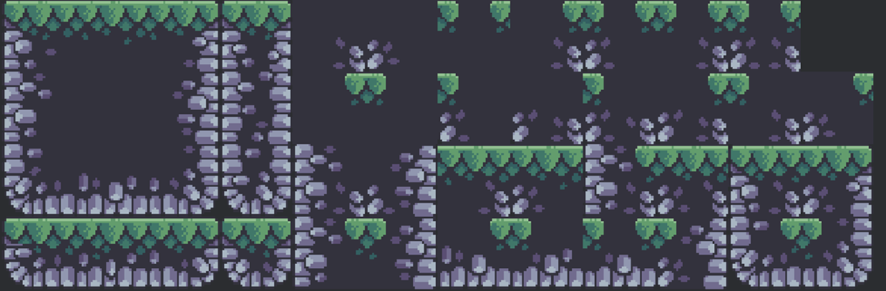
The nested loop extracts smaller sprites (32x32 pixels each) from the sprite atlas and stores them in the levelSprite array
LEVEL DATA - LOAD
SUPER MARIO
the levelSprite array

Slide 9
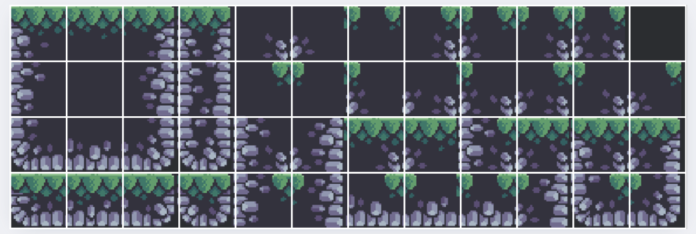
LEVEL DATA - LOAD
The nested loop extracts smaller sprites (32x32 pixels each) from the sprite atlas and stores them in the levelSprite array
the levelSprite array
SUPER MARIO

Slide 10
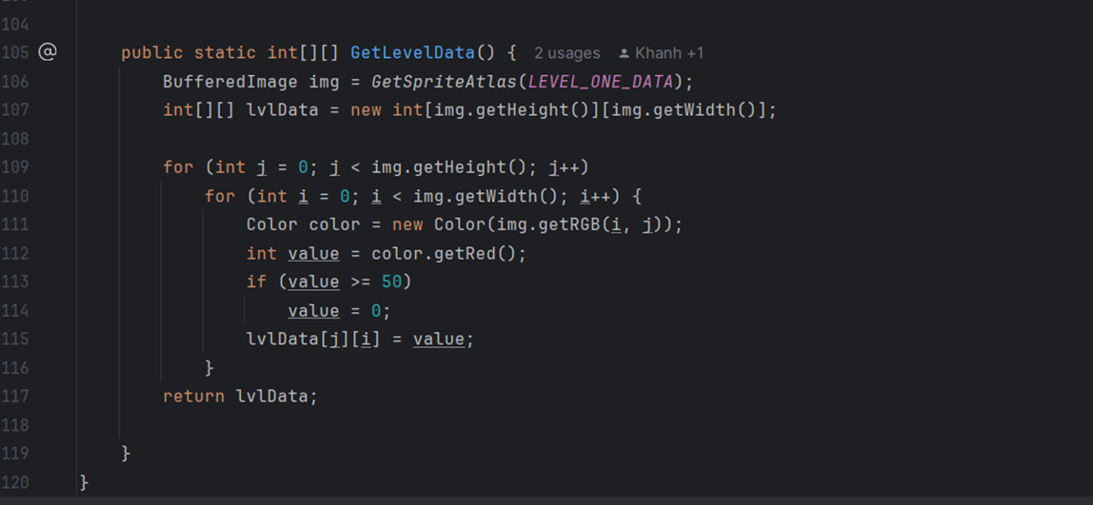
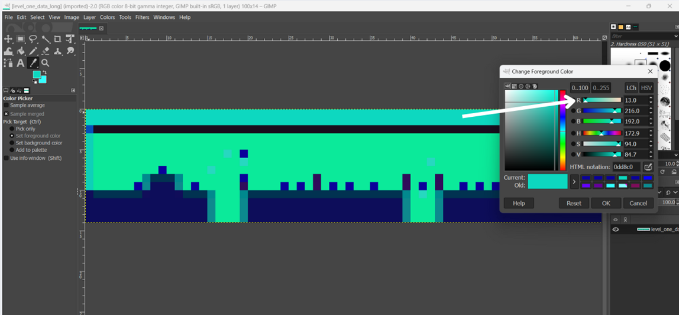
LEVEL DATA - LOAD
For each block, we assign the red color value of the corresponding pixel to the specific index in the levelSprite array where we want to draw the block.
SUPER MARIO

Slide 11
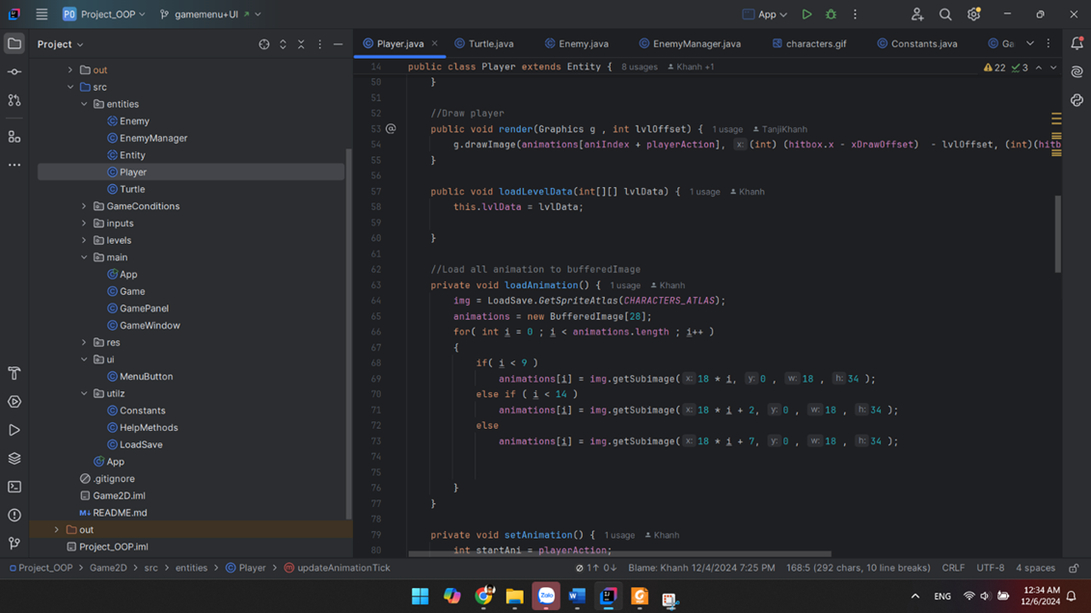
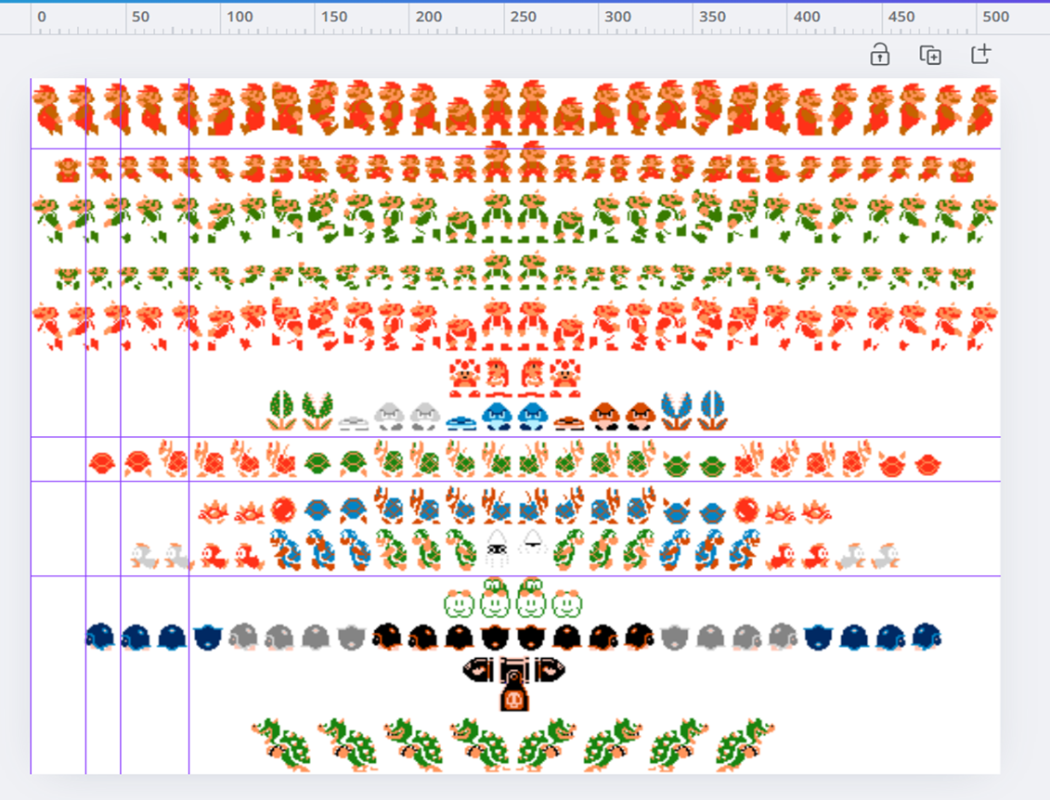
MARIO ANIMATION
SUPER MARIO

Slide 12
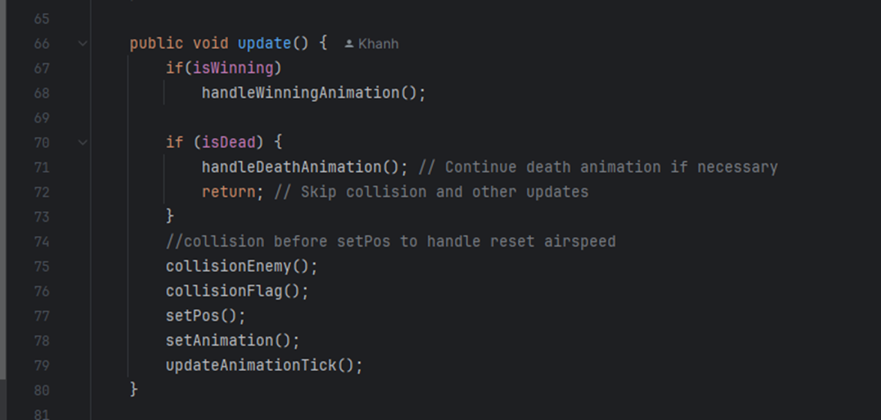
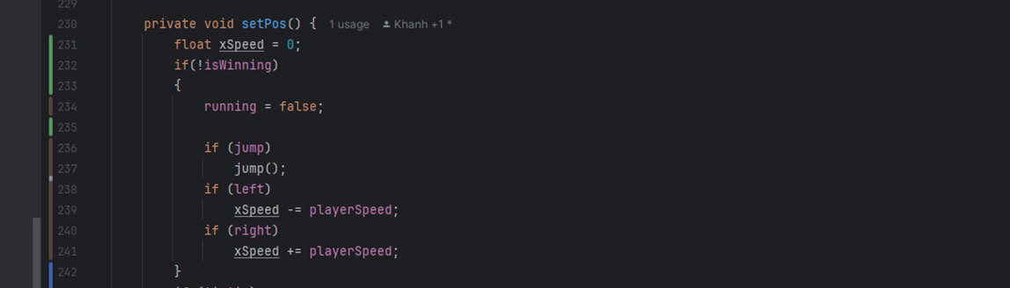
MARIO ANIMATION
SUPER MARIO

Slide 13
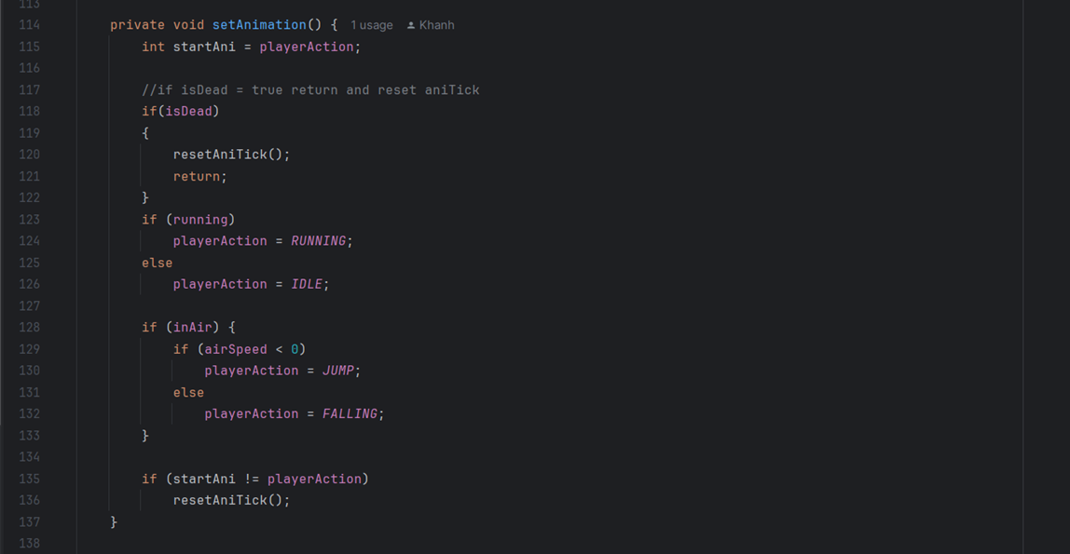
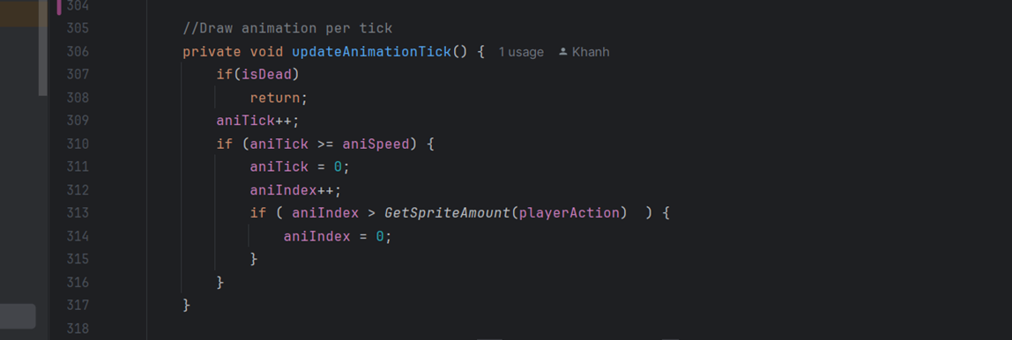
MARIO ANIMATION
SUPER MARIO

Slide 14
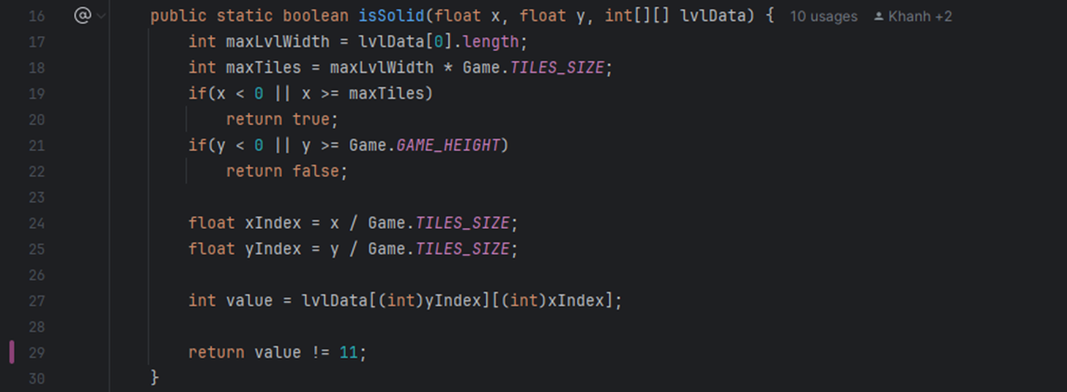
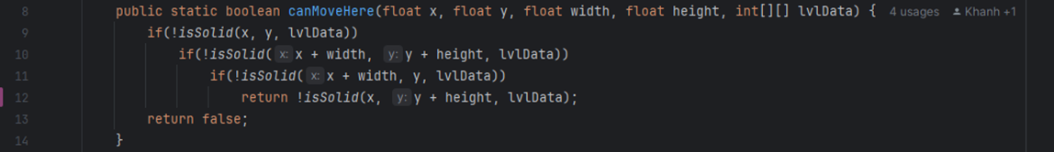
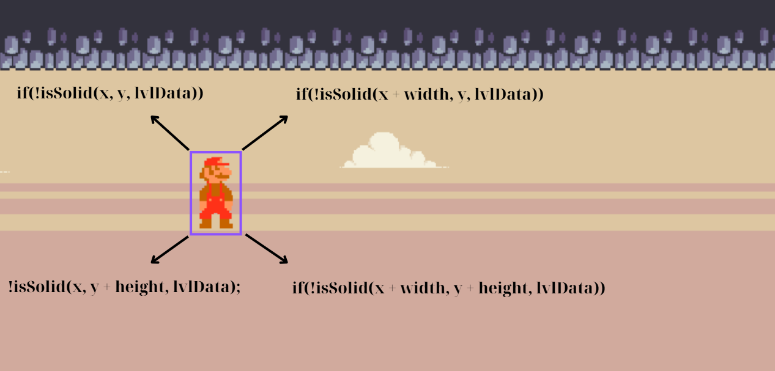
COLLISION
SUPER MARIO

Slide 15
COLLISION
SUPER MARIO

Slide 16
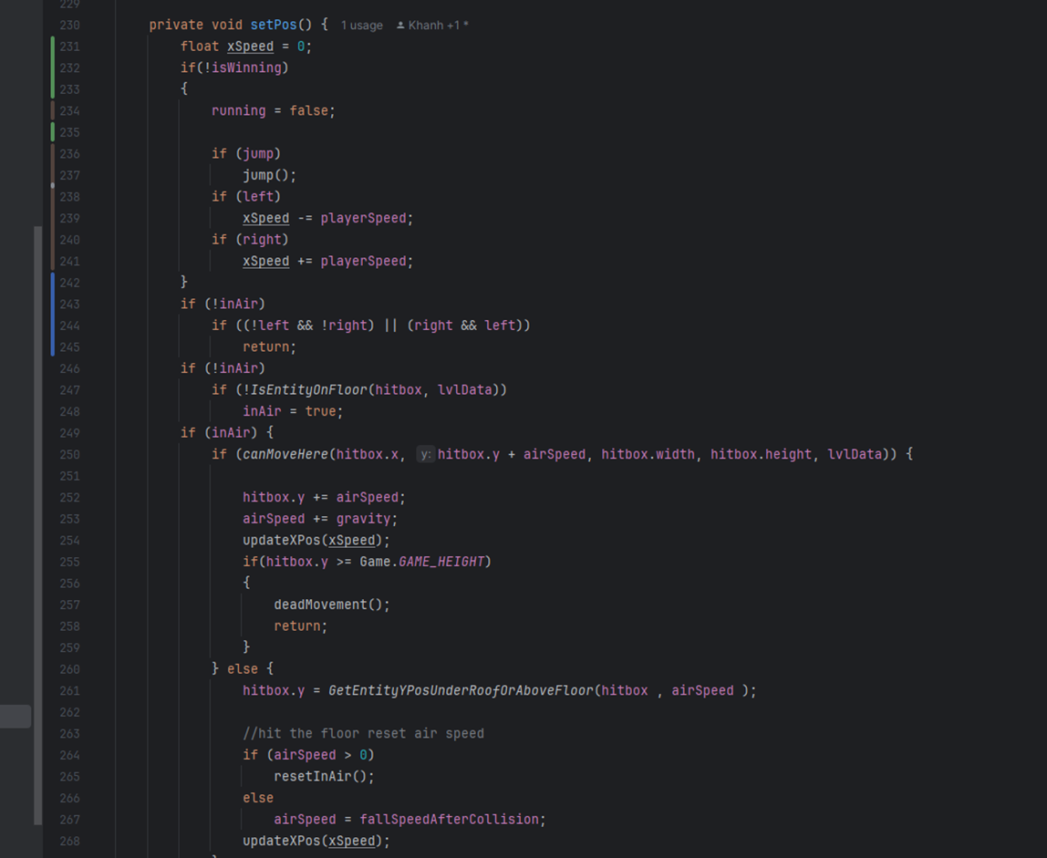
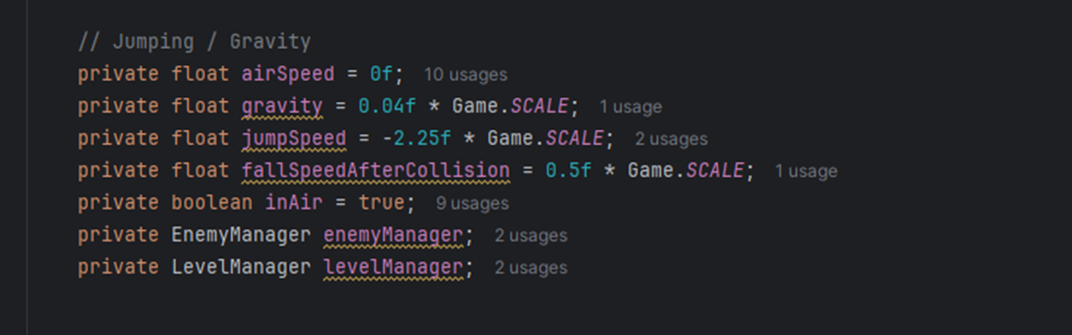
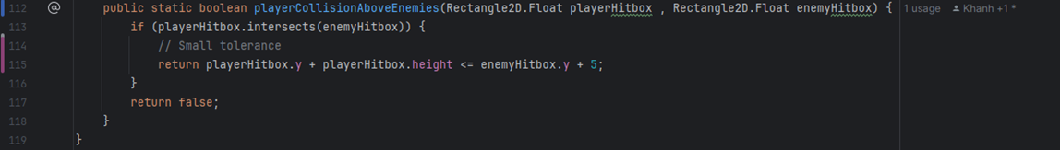
Gravity
If the player is not already airborne (inAir = false), the function checks whether the player is on the ground using IsEntityOnFloor. If not, the player enters the airborne state (inAir = true)
When airborne, the function:
Check if the player can move to the next vertical position (canMoveHere).
If movement is possible:
Updates the hitbox.y position based on airSpeed.
Increments airSpeed by gravity to simulate acceleration.
SUPER MARIO

Slide 17
If the player is not already airborne (inAir = false), the function checks whether the player is on the ground using IsEntityOnFloor. If not, the player enters the airborne state (inAir = true).
When airborne, the function:
Check if the player can move to the next vertical position (canMoveHere).
If movement is possible:
Updates the hitbox.y position based on airSpeed.
Increments airSpeed by gravity to simulate acceleration.

Slide 18
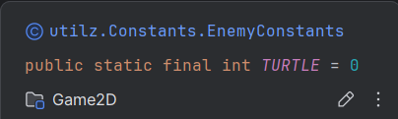
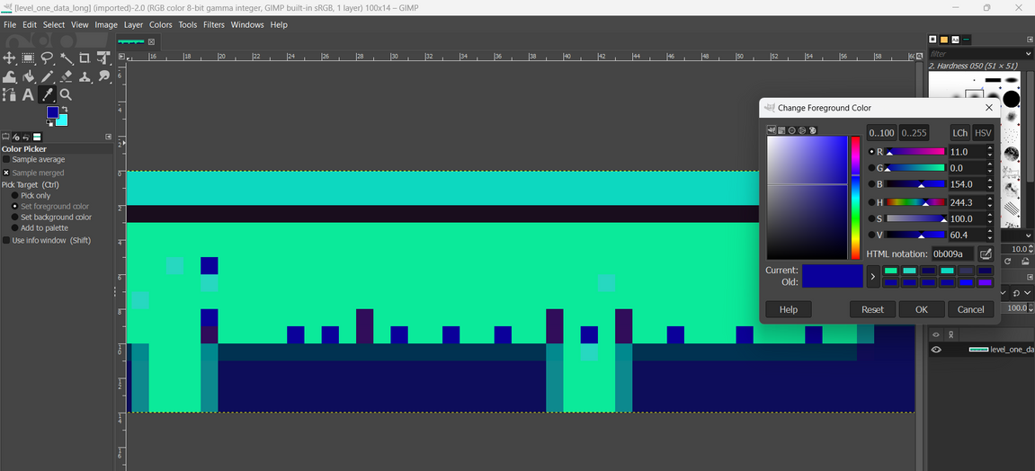
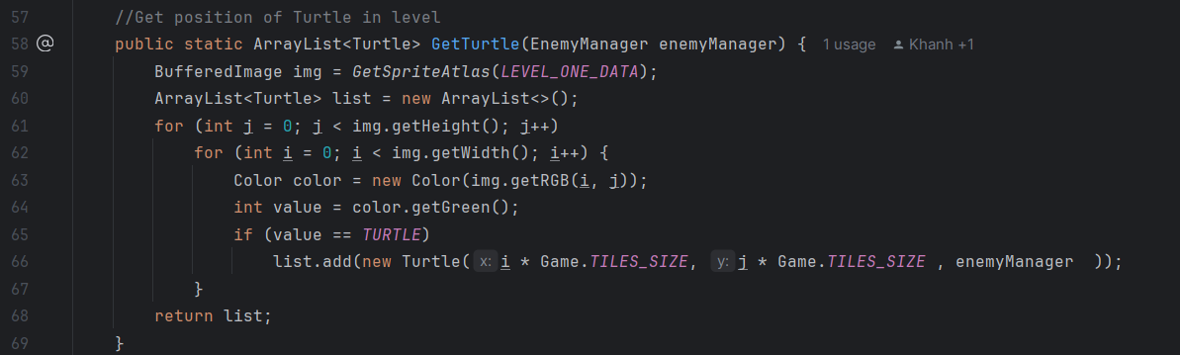
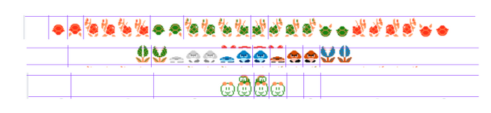
Enemies Animations
Load the level data image using the GetSpriteAtlas method
Iterate through each pixel in the image
Create a Mushroom object at the position derived from the pixel's coordinates
Add the Mushroom object to the list

Slide 19
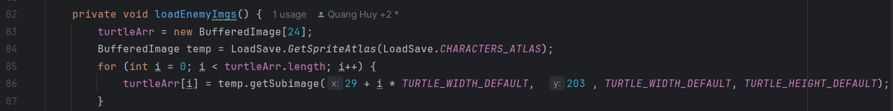
How to load Enemies and draw Image of each type
Load Enemies’ Image
iterates through each frame for a given enemy type
iterates through each frame for a given enemy type
Stores each frame in the corresponding array (turtleArr, mushroomArr, jokerArr)
SUPER MARIO

Slide 20
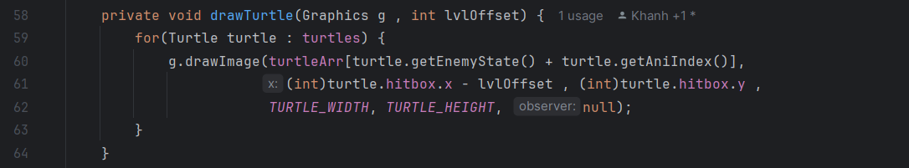
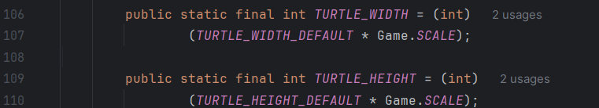
How to load Enemies and draw Image of each type
Draw enemies' image
1. Choosing the correct sprite for the current animation frame and state.
2. Positioning the sprite based on the Enemies's position (hitbox.x, hitbox.y).
SUPER MARIO
3. Scaling the sprite to the correct width and height.

Slide 21
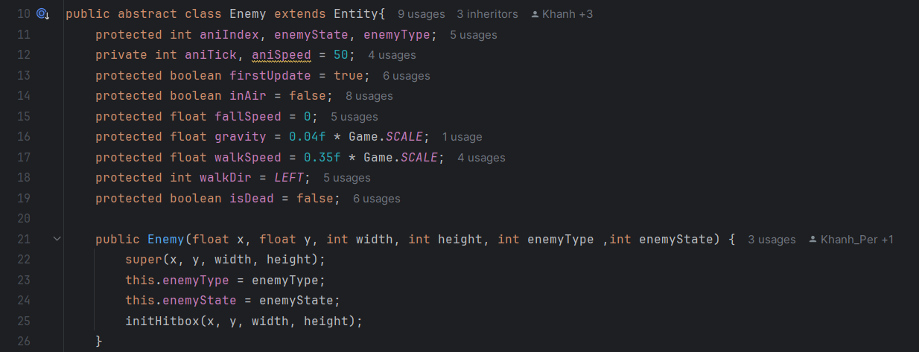
Why enemy is the abstract class?.
Enemy class is an abstract class, because it represents a base template for all enemy types in the game. It contains common properties and methods shared by all enemies, including movement, etc.
updateMove(int[][] lvlData):
abstract method for enemy-specific movement logic. Each enemy type (e.g., Turtle, Mushroom, Joker) must implement this method.
SUPER MARIO

Slide 22
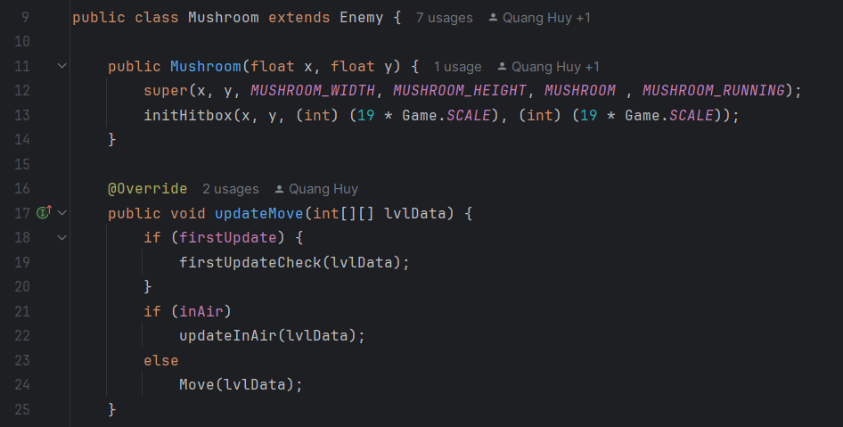
Why enemy is the abstract class?.
Class Mushroom.
firstUpdateCheck: Runs initial setup (e.g., setting starting states)
Movement:
+ If the mushroom is in the air (inAir), the updateInAir method is called, likely handling gravity or falling logic.
+ Otherwise, the Move method handles normal movement, such as walking to the player.
SUPER MARIO

Slide 23
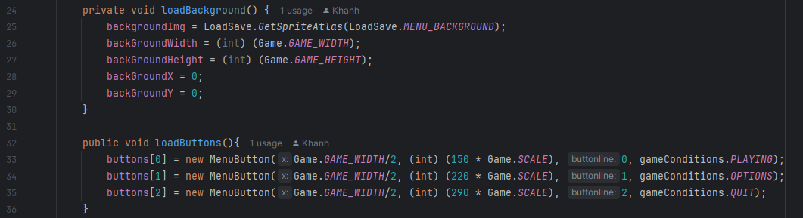
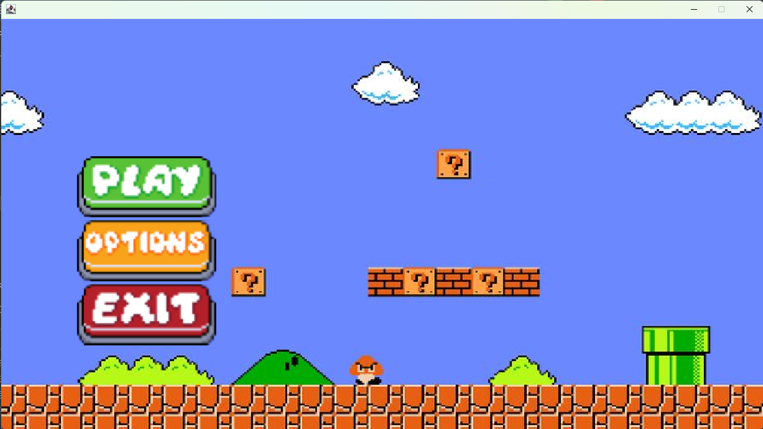
RUN GAME - MENU
SUPER MARIO

Slide 24
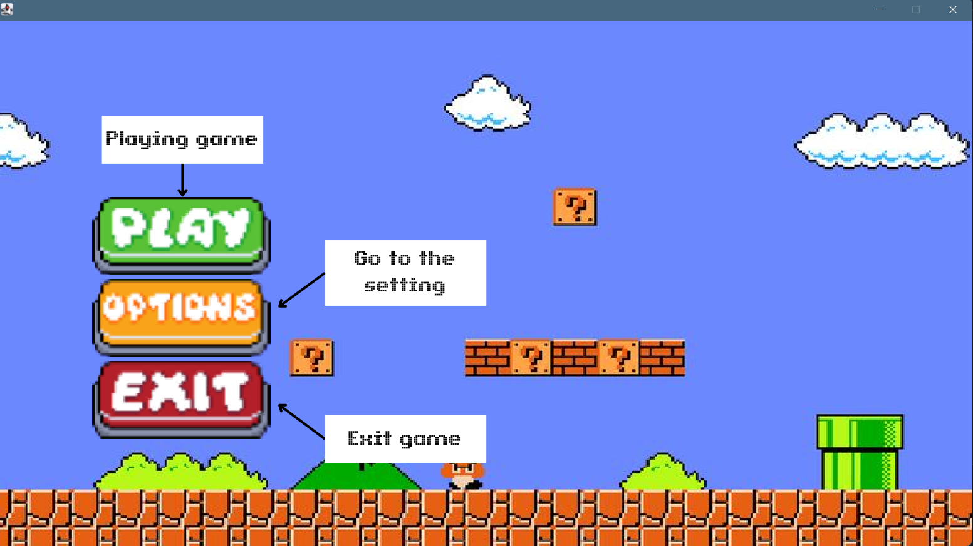
MENU
BUTTONS

Slide 25







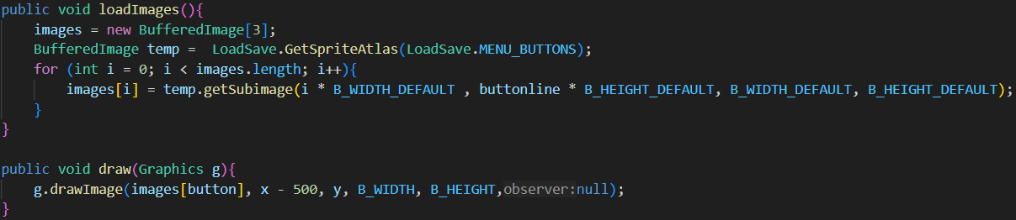


Slide 26


